Slide 1

Restaurant Analysis of SWIGGY
Naveen Ramesh
BADM-WD-T-B5

Slide 2
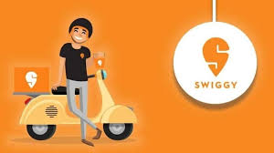
About Swiggy
Swiggy is a leading Indian food delivery platform founded in 2014.
It connects users with local restaurants for ordering food and offers fast doorstep delivery.
Beyond food, Swiggy also provides services like Instamart (grocery delivery) and Swiggy Genie (parcel delivery).
The platform operates in over 500 cities and competes with Zomato and other delivery services.
Swiggy's key strengths include a large restaurant network, real-time tracking, and tech-driven logistics
Owners: Prosus, SoftBank Group, Accel
Founders: Sriharsha Majety, Nandan Reddy, Rahul Jaimini
Headquarters: Bangalore, Karnataka, India

Slide 3
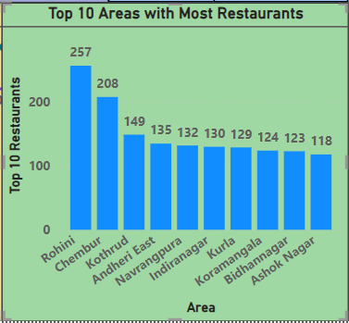
Top 10 Areas with Most Restaurants
This chart shows the top 10 Areas with the most number of Restaurants.
The Area Rohini from Delhi has the highest number of Restaurants(257).
Followed by Chembur(208), Kothrud(149), Andheri East(135), Navrangpura(132), Indiranagar(130), Kurla(129), Koramangala(124),Bidhannagar(123), Ashok Nagar(118).

Slide 4
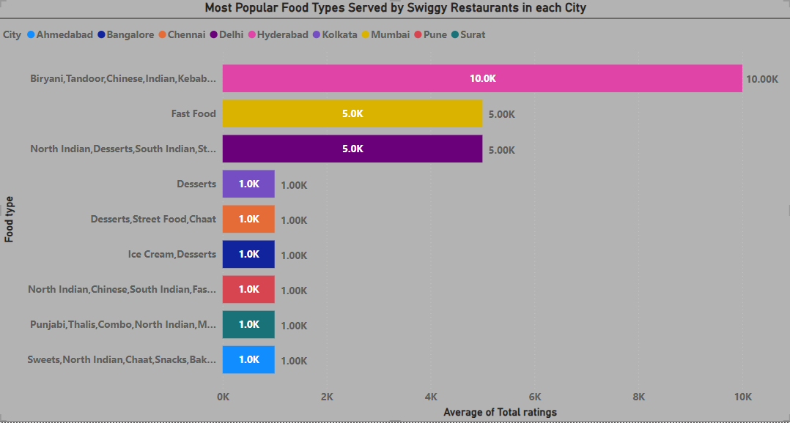
Most Popular Food Types Served by Swiggy Restaurants in each City
The most popular food types served by Swiggy restaurants are Biriyani, Tandoor, Chinese, Indian, and Kebab, which are highly rated in Hyderabad (Total rating: 10K)
Followed by Fast food in Mumbai(5K ratings), North and South Indian, Desserts in Delhi(5K Rating) and Sweets, Chats, Snacks in Surat(1K Ratings).

Slide 5
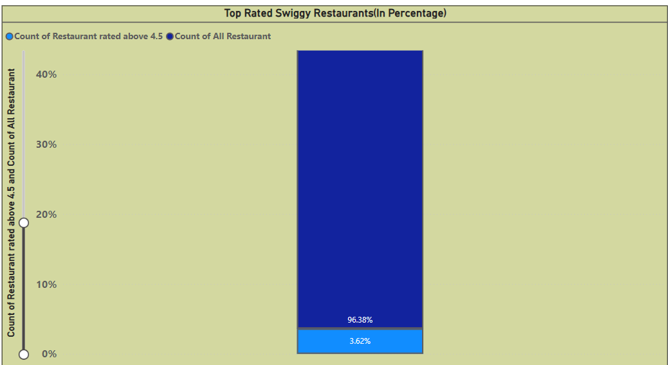
Top Rated Swiggy Restaurants(In Percentage)
The Percentage of Top Rated Swiggy Restaurants, which are above 4.5 Average Rating are 3.62%.
Whereas the Restaurants, which are below 4.5 Average Rating are 96.38%.

Slide 6
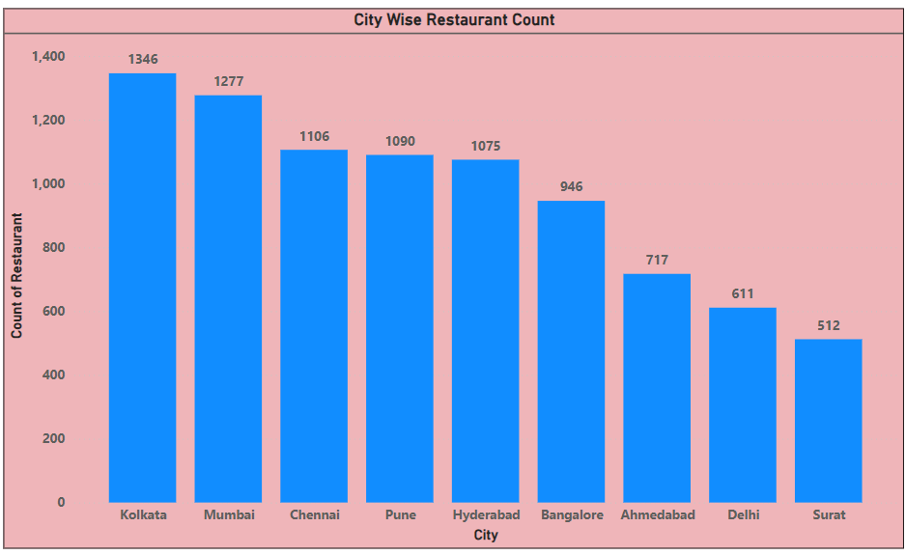
City Wise Restaurant Count
The City Kolkata from Delhi has the highest number of Restaurants(1346).
Followed by Mumbai(1277), Chennai(1106), Pune(1090), Hyderabad(1075), Bangalore(946), Ahmedabad(717), Delhi(611) and Surat with the least numbers of restaurants(512).

Slide 7
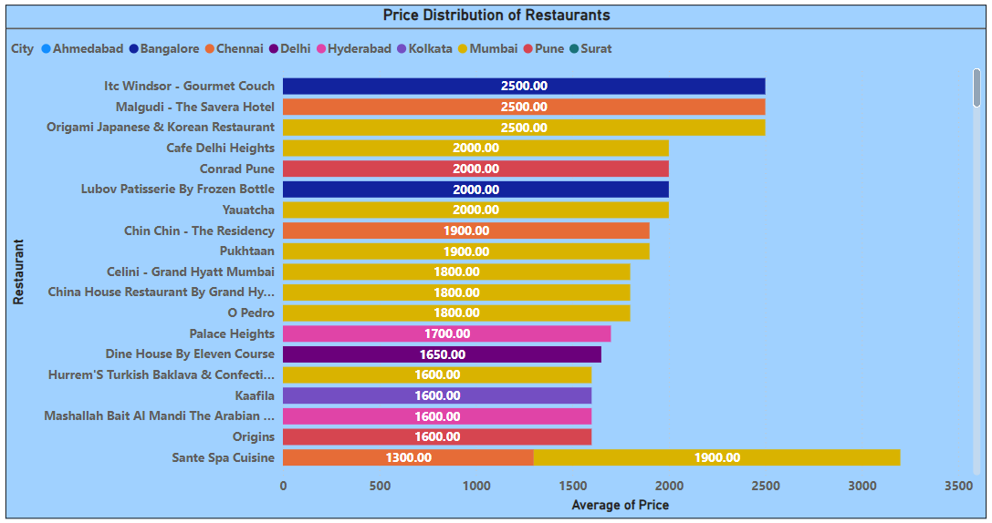
Price Analysis
This chart shows the average Price determined in a Swiggy Restaurants, the restaurant ITC Windsor – Gourmet Couch from Bangalore, Malgudi – The Savera Hotel from Chennai and Origami Japanese & Korean Restaurant from Mumbai are priced high(2.5K) among the other Swiggy Restaurants.
The Least average price of Restaurants is 700Rs.

Slide 8
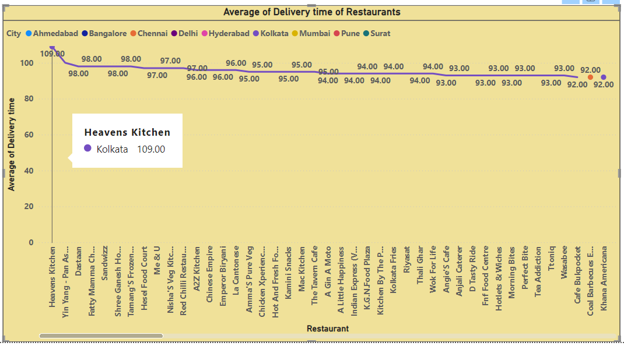
Delivery Time Analysis
This Line Chart analyzes the average delivery time of restaurants.
The highest average time taken by the restaurant to deliver the food is Heavens Kitchen located in Kolkata(109 Min).
The least average time taken by the restaurant to deliver the food is Scoops located in Hyderabad(20 Min).

Slide 9
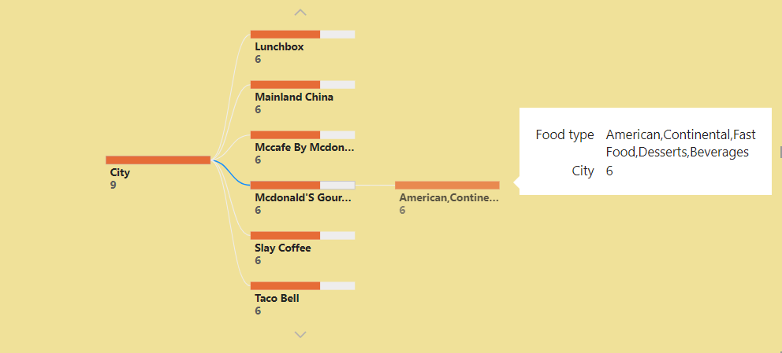
Cuisine Analysis
This Tree Chart describes the cuisines offered by the restaurants.
In the Chart the, we can see that the Restaurant Mcdonals Gourmet Burger Collection located in 6 cities offers American, Continental, Fast food, desserts and Beverages cuisines.

Slide 10
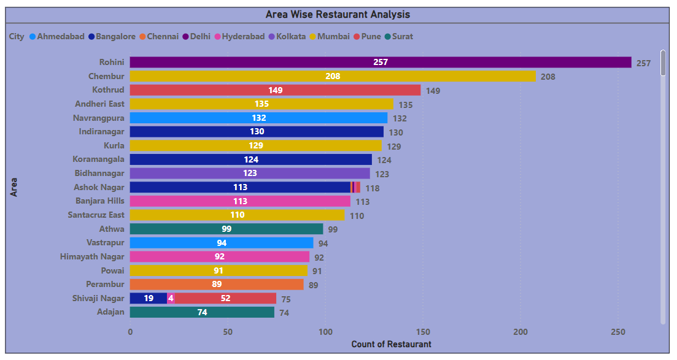
Area Wise Restaurant Analysis
The Area Rohini from Delhi has the highest number of Restaurants(257).
Whereas, the lowest number of Restaurants(1) available in few areas also.

Slide 11
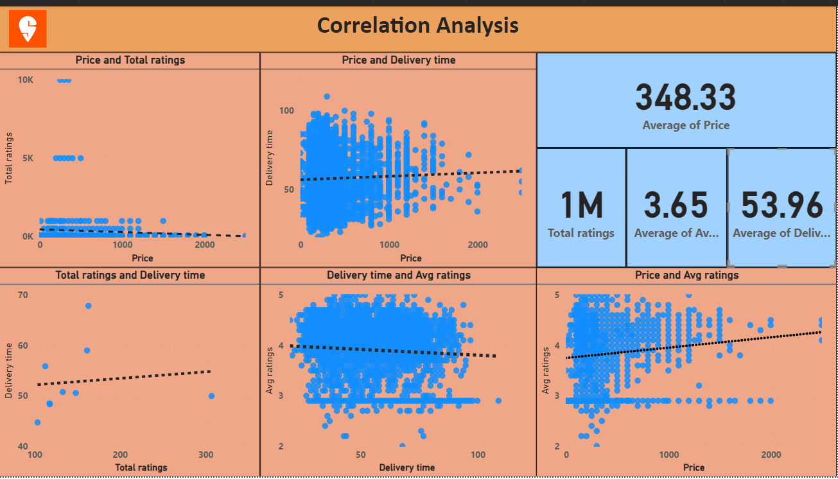
Correlation Analysis Between Price, Rating(Avg & Total Rating) & Delivery Time
This Scatter Chart describes the Correlation Analysis(Correlation Coefficient is -1 to 1)Between Price, Rating(Avg & Total Rating) & Delivery Time.
The Price and Total Ratings is weak negatively correlated, as we can see slight dip in the trend line, ie)when Price increases total rating deceases.
The Price and Delivery time is weak positively correlated, as we can see slight rise in the trend line, ie)when Price increases delivery time also increases.
The total Ratings and delivery time is weak positively correlated, as we can see slight rise in the trend line, ie)when total rating increases delivery time also increases.
The delivery time and Avg rating is weak negatively correlated, as we can see slight dip in the trend line, ie)when delivery time increases avg rating deceases.
The Price and Avg Ratings is Moderate positively correlated, as we can see rise in the trend line, ie)when Price increases Avg rating increases.

Slide 12
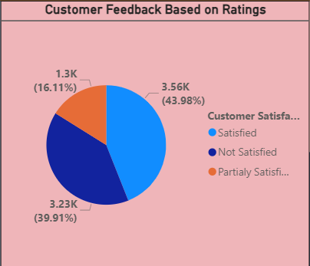
Customer Feedback Analysis
This Pie chart describes the Customer Feedback analysis based on Average rating
43.98% of the customers are satisfied with the restaurant services(Avg rating >= 4).
16.11% of the customers are partialy satisfied with the restaurant services(Avg rating >= 3)
39.91% of the customers are not satisfied with the restaurant services(Avg rating >= 2).

Slide 13
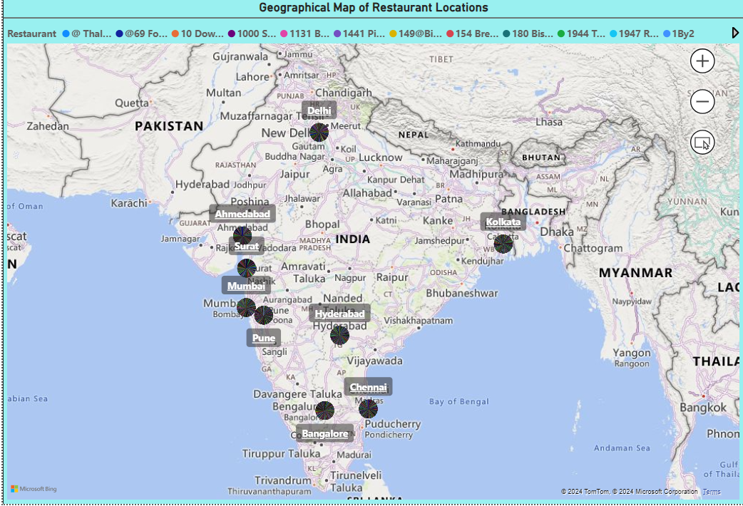
Geographical Mapping
This is the Geographical Map of Restaurant locations available under each city.

Slide 14
Business Recommendations
The Business Recommendations are as follows based on the Analysis we have seen:
The Percentage of Top Rated Swiggy Restaurants, above 4.5 Average Rating is only 3.62%, which is the alarming note. Swiggy needs to work on the quality of services in logistics, customers feedback for the remaining 96% of restaurants which are rated below 4.5.
Swiggy must work on the logistics and delivery time in Kolkata city, as most of the restaurants has high delivery time.
Swiggy has to concentrate more in Pune, as most of the Restaurants in Pune has less Avg and Total ratings.
Swiggy can expend their services all over India, as their services available only in nine major cities in India.
16.11% of the customers are partially satisfied with the restaurant services and 39.91% of the customers are not satisfied, here Swiggy must improve the ratings given the Customers.
From the Correlation Analysis, when the Price increases the total rating deceases. Hence customer giving ratings based on price, when the price ranges altered based on the ratings, there is possibility of getting high customer ratings.
From the Correlation Analysis, when the Delivery time increases the Avg rating decreases. Hence customer giving ratings based on delivery time, when the delivery time is less there is possibility of getting high customer ratings.

Slide 15
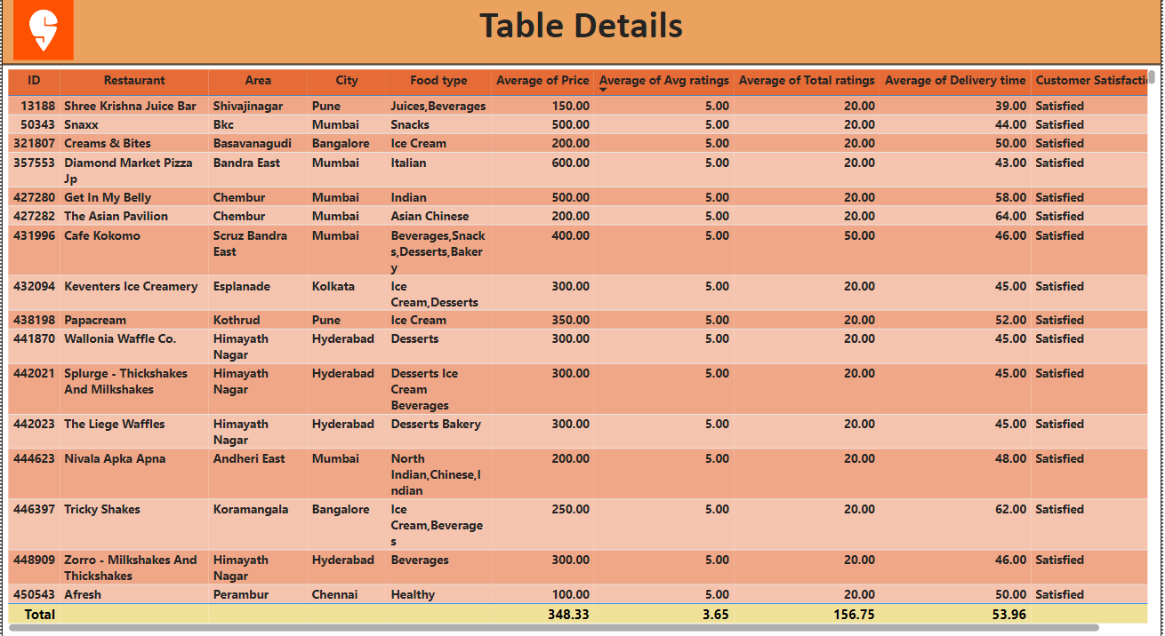

Slide 16
Thank You!

